Slide 1
St Mary’s C of E Primary School
School Prospectus
Notes:
A template for students to design a field trip to a location for other students to view. Includes instructions for the student of what to include on each slide and what content should be considered.

Slide 2
Welcome :
It is a privilege to be head at St Mary's Church Of England Primary School. I am passionate about improving outcomes for all the children and it is an honour to be able to fulfil this role.
We are all very proud of our children and their achievements, but we are equally proud of the compassionate and independent children they become. Our vision is to give children and adults in our school community every opportunity to enjoy life in its fullness.
St Mary's is a warm, friendly and very popular school. As a Church of England school, our Christian Vision and Values are at the heart of everything we do. Pupils love coming to our school because they are taught by dedicated, talented and experienced professionals who ensure that our pupils are given every opportunity to succeed.
We believe that through offering an exciting and enriching curriculum delivered by interested and interesting adults, each child is inspired to develop their talents and skills and so achieve their potential. We strive to extend pupils' understanding of local, national and global issues so that they can challenge injustice and more confidently reflect their concern for God's world and people, to become advocates for compassion and change.
I hope that this prospectus will give you a flavour of all the exciting learning going on in our school. However, if you want to see us in action, please call the school office where Mrs Jackson the Business Manager would be delighted to answer any of your queries or show you around. I am confident that when you leave us you will want to come back and that you will feel the strong sense of community that so many of our visitors comment upon.
Working in such an environment is a real gift. Every day is different, but each day is filled with fun and laughter. I would not want to work anywhere else!
Rachel Tainsh

Slide 3
Our vision is to inspire and grow a compassionate community of excellence. A place for our children to shine for God, for each other, and for themselves.
St Mary’s has developed a vision that encourages everyone to flourish. This vision is worked out through our school aims.
Our Aims
Deeply rooted in the love of Jesus we are committed to -:
Creating a happy, healthy and honest school, where everyone feels secure and valued.
Providing excellent teaching and learning opportunities which develop independent, confident, and resilient life long learners who
can think for themselves.
Celebrating and supporting all children to unlock and fulfil their unique potential.
Preparing children to contribute to society with wisdom, hope, tolerance, and dignity.
Living by our school values of Love; Honesty; Courage; Compassion; Determination and Respect.

Slide 4
What others say …..
Parents Ofsted
‘I don’t know one child who has left St Mary’s and not loved the time they spent there.’
‘The school is a calm, happy and welcoming place.’
‘It’s a joy to see how the teachers give so much of their time to the children.’
‘Your Christian values have created an inclusive and nurturing environment.’
‘Absolutely marvellous – very friendly atmosphere.’
‘You set high expectations for the behaviour and conduct of both pupils and staff. Pupils behave well in class and around school. Conduct across the school during the inspection was of the highest standard.’
‘Our children have grown into beautiful, thoughtful and caring young people, and St Mary’s has played a large part in making that happen’.
‘You have made our son feel safe and loved and have laid an amazing foundation for his learning.’
‘A wide range of learning activities engage children’s imaginations and develop their independence skills.’

Slide 5
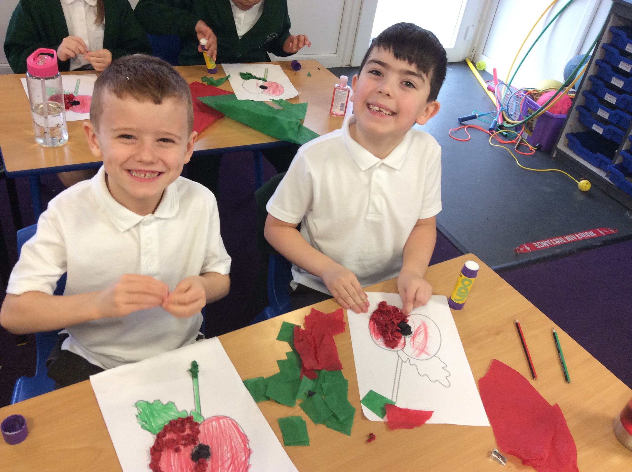
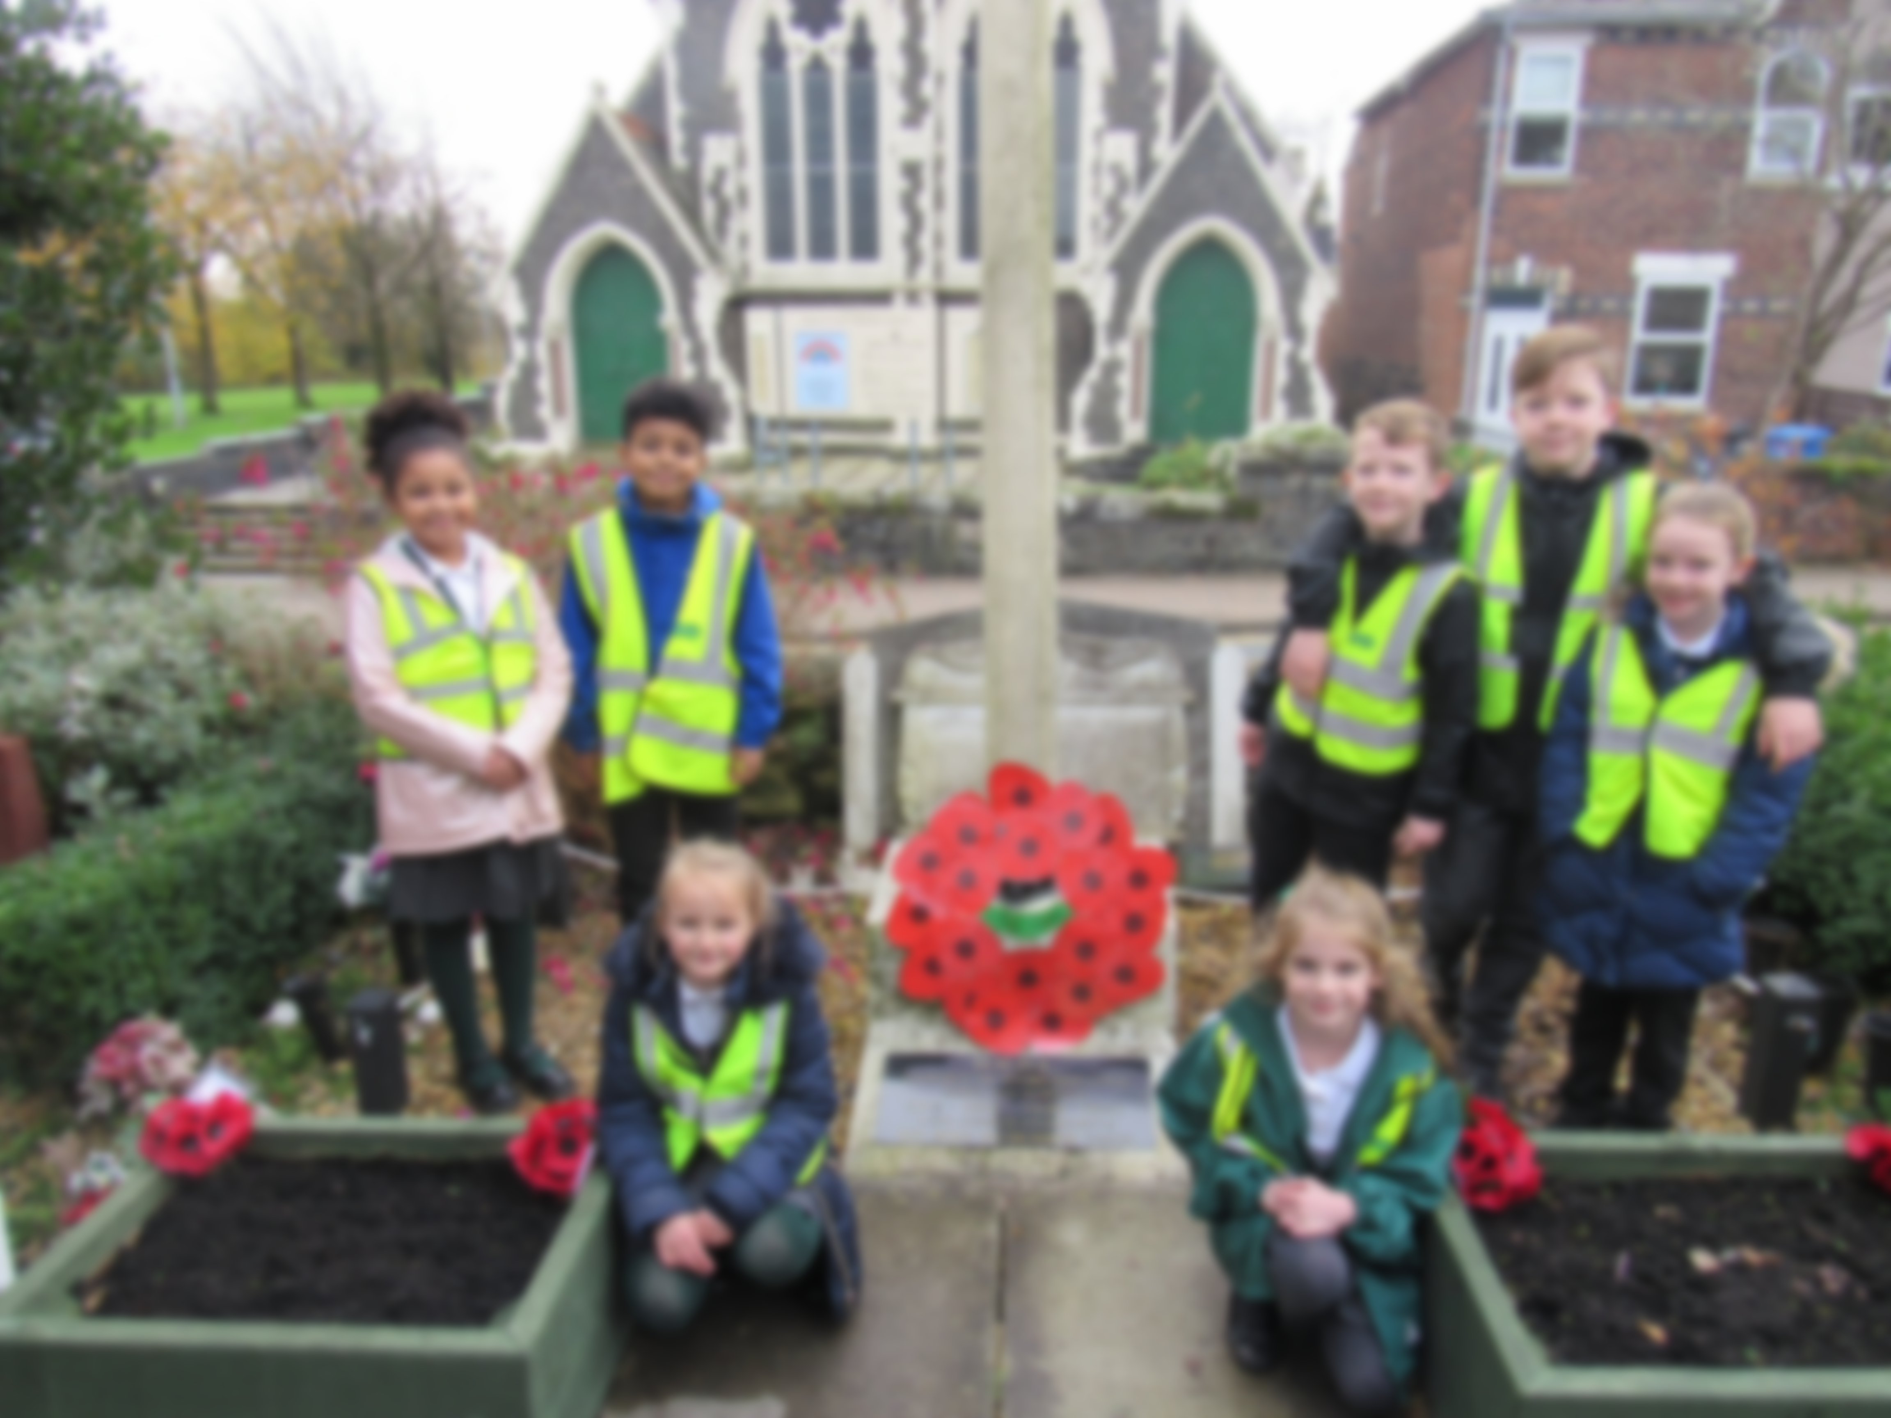
Siams Inspections – SIAMS inspections provide Church schools with a tool for effective self-evaluation. Here are some quotes from our last external review.
The school is a beacon of love, care and compassion in the community.
The pupils’ excellent behaviour, respect for each other and positive attitudes stem from the school’s core Christian values of honesty, love, courage, determination, compassion and respect.
An outstanding commitment to the development and well-being of every pupil underpins the school’s work and is rooted in Christian love. High expectations and encouragement are directly linked to the Christian life of the school.
Pupils make very good progress from low starting points because they feel loved, secure and able to learn.
The school knows its pupils and their families extremely well and meets individual needs through a culture of Christian nurturing, support and compassion.
The school is outward-looking and plays a full role in local cluster initiatives.
The outstanding Christian leadership of the Headteacher and her vision for the development of the school ensure that the distinctive character and ethos are of the highest priority. The Headteacher is supported by a strong senior leadership team and governing body. They are committed to fostering all aspects of pupils’ development and well-being through Christian care and love.

Slide 6
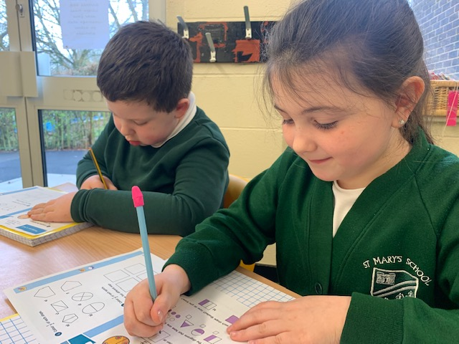
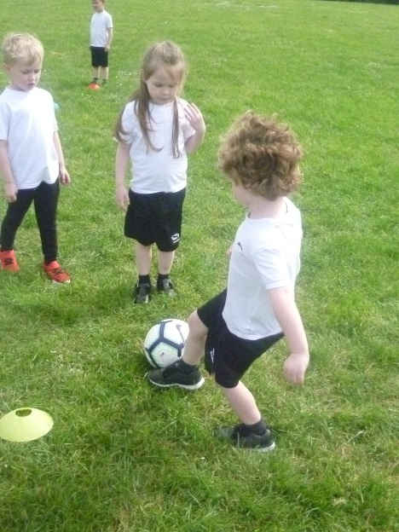
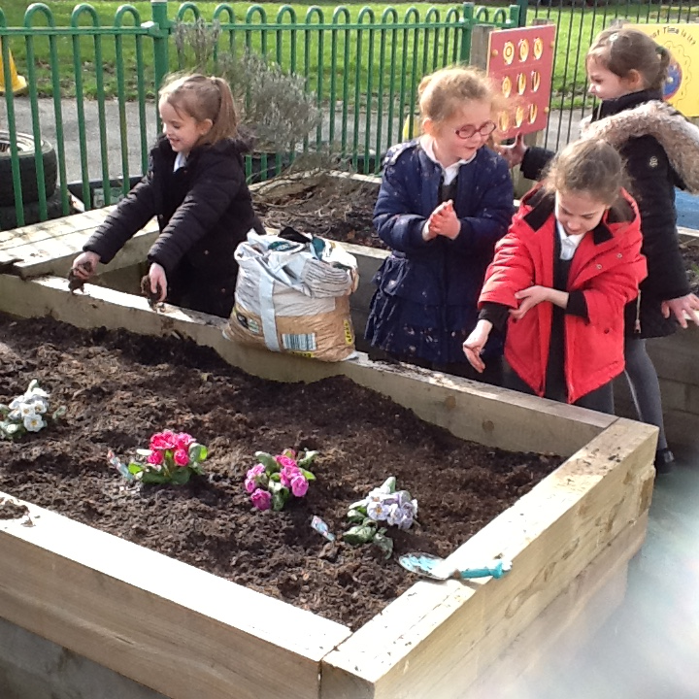
School Day
We start at 8.50am and finish at 3. 15 pm.
Children come straight into their classrooms, and parents pick up from their child’s classroom. All children need to bring their book bag each day with their reading book, a freshly filled water bottle and keep a P.E. kit in school.
Please call the school office if for any reason a different person will be picking up your child.

Slide 7
Things you need to know St Mary’s is a Church of England Primary School and Nursery for children aged 3 to 11. The school is a lively, happy place where all are treated as individuals within a Christian family atmosphere. We ensure that the children benefit from a rich, balanced curriculum that is presented in an exciting and imaginative manner with lots of opportunities for first hand experiences, investigation and learning through play. Staff, parents and governors work very hard to give our children the education they deserve and experiences they will remember. The curriculum is enriched by visits, visitors and extensive use of the environment. We celebrate all our children’s individual strengths and achievements.
School uniform
Uniform must be worn every day. All items need to be marked with your child’s name. School jumpers, cardigans and polo shirts,
- White polo shirt
Green jumper or cardigan
Grey trousers or skirt
Black shoes
In summer a green or yellow checked dress and optional grey shorts.
No jewellery is allowed at St Mary’s.
One pair of small stud earrings may be worn, but will need to be covered with a plaster for P.E. sessions
Hair bobbles should be unobtrusive and no nail varnish should be worn
No flip flops to be worn
P.E. kit
Kept in drawstring bag in school
Trainers
White T Shirt
Black shorts
Black joggers in winter
(optional)
Lost Property
The school can not accept responsibility for any lost property. All clothing should be clearly marked and unnecessary items left at home
Behaviour
We pride ourselves on the positive relationships between staff and children.
We encourage our children to develop self-discipline and to be aware of the needs of others. Although this is a forward thinking school our Behaviour Policy is based on good old fashioned manners and respect for others!
Our school rules are
Be ready
Be respectful
Be safe.

Slide 8
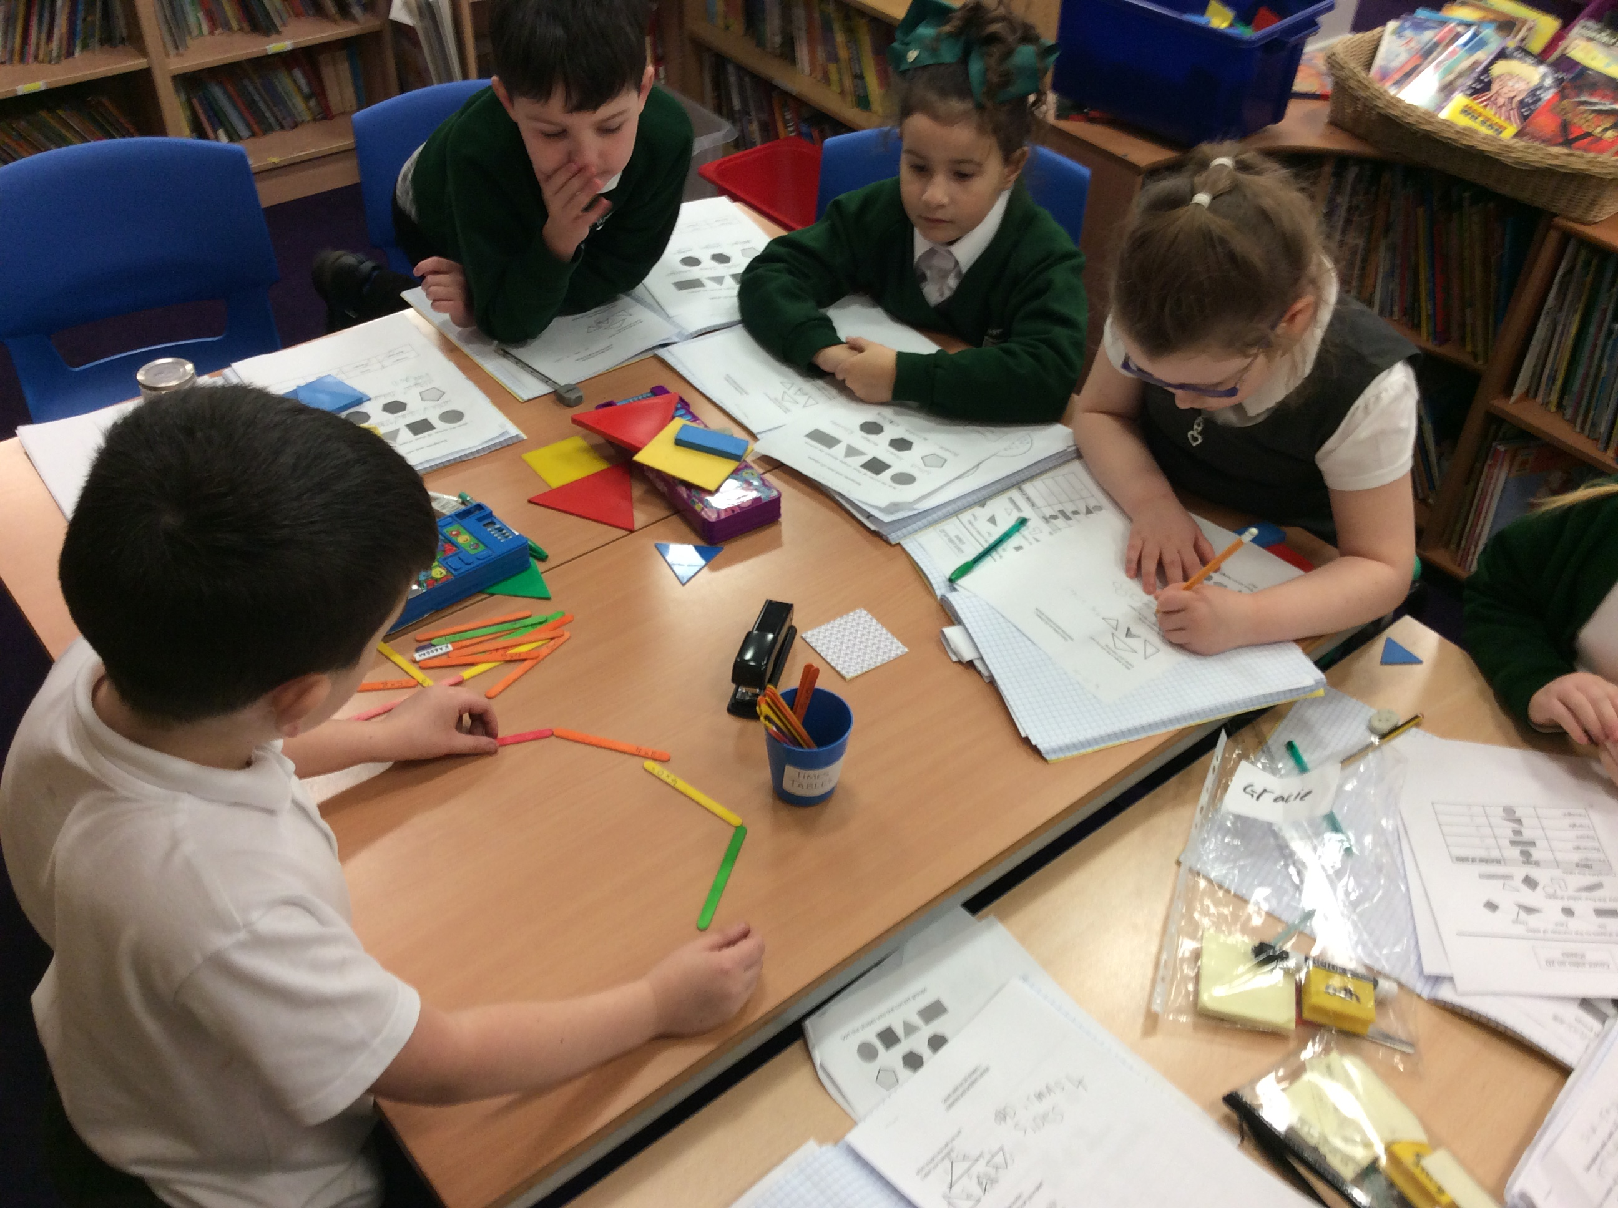
Attendance
Attendance
As a Church of England school, St Mary’s believe that all children are loved by God, are individually unique and that the school has a mission to help each pupil to fulfil their potential. If pupils are to get the greatest benefit from their education, regular and punctual school attendance is important. Children are expected to attend school for the full 190 days of the academic year in order to receive their educational entitlement. Children with poor attendance tend to achieve less well than their peers.
Registration
Due to the current Covid-19 pandemic, registration times are staggered and these changes will remain in place until further notice. Parents and are asked to support this through prompt arrivals and departures at their classroom doors. If a pupil arrives late, they will receive a late mark. Registration is taken promptly each morning between 9am and 9:15am (depending upon the class start time) and again in the afternoon following lunch break. A child arriving after 9:30am will be marked as having an unauthorised absence for the morning.
Absence
Parents/carers should contact the school on the first morning of their child’s absence, providing details of the reason for their absence. If the school has not been informed of any absence by 9:30am, the administration staff will try and contact the family, keeping a record of steps taken.
Leave of absence
Parents and carers requesting leave of absence for anything other than medical reasons must make a request in writing in advance. Leave of absence for holidays can no longer be authorised due to changes in Government legislation. All leave of absence is at the Headteacher’s discretion and will be granted only for exceptional circumstances. When leave of absence is unauthorised, it may be necessary to impose a fine.
For more information about attendance, please see the Attendance Policy on our website.

Slide 9
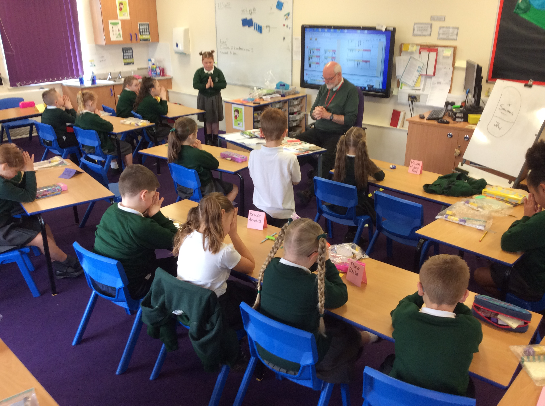
COMMUNICATIONS WITH PARENTS
Our website will give you a flavour of what is going on in school, but we do have an open-door policy so if you have any concerns or would just like to see what your child has been doing, please feel free to contact your child’s teacher.
At the start of the Autumn term, parents / carers are invited to a ‘meet and greet session’ with their teacher. This gives the teachers and parents an opportunity to understand the new expectations and any changes that may arise as the children move from one year group into the next. Later in the Autumn term, parents are invited into school again to discuss their child’s targets and how well they have settled into their new class. This is followed by a second Parents’ Meeting in the Spring term; to provide parents with an update on how well their child is progressing. Finally, parents receive a detailed written report in the Summer term. End of key stage attainment is also recorded in this summer report. Each month, a newsletter goes out to every home, outlining events and achievements.
School uses a web service - to send texts and messages to parents / carers. We ask all parents to engage with us in this. Parent evening appointments can also be booked in this way.
Twitter is a wonderful way of keeping in touch daily with what’s happening.
Collective Worship
We love parents/carers and grandparents to join us on the first and third Wednesdays of the month for our Family Worship. Come and join us for a thought provoking, all age session of stories and songs. We are blessed to have a number of folk who come and lead this for us including the vicar of St Mary’s.
We will also invite you to special occasions like our Christingle service, Easter service and class led worship sessions throughout the year.

Slide 10
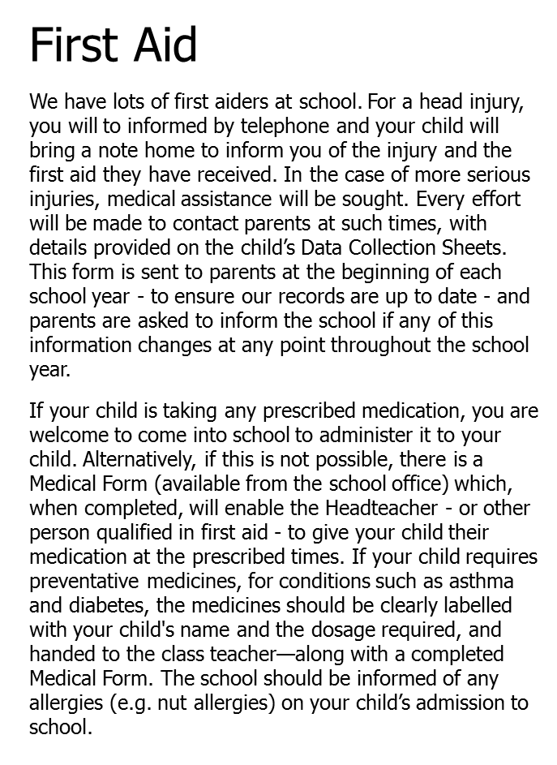
School lunches
All Reception, Year 1 and 2 pupils are entitled to free school meals. We would urge parents to take up this offer, even fussy eaters seem to eat when they are with their friends, and we will never let a child go hungry.
Parents have two choices for their children:
A hot, healthy school meal (provided by Halton Catering Service);
A healthy packed lunch (brought from home).
We encourage all of our children to eat healthily, both at home and in school. The hot, healthy school menu ensures that your child will receive a hot, nutritional, balanced diet.
As we have been awarded the ‘Healthy School Standard’, we promote healthy packed lunches. This could include a sandwich with your child’s favourite filling, but try not to use the same filling every day. Experiment with new things such as grapes, cherry tomatoes or kiwi fruit.
Due to government guidelines, crisps, sweets and chocolate should not be included. Flavoured water would be a healthy option, but please avoid fizzy drinks. Chilled water will always be available in the dining hall.
For those required to pay, Lunch money is paid on the School Gateway App.

Slide 11
Curriculum More than anything we want our children to be happy and thrive in a constantly changing world. We follow The Early Years Foundation Stage Curriculum and The National Curriculum. However, we have developed a bespoke mastery curriculum, driven by the aims and values of our school and supported by the Chris Quigley Essential Curriculum. We recognise that not all children have the same experiences and as a school we have the unique opportunity to ensure all children have deep and rich cultural experiences. We place a strong emphasis on securing the basic skills of reading, writing and mathematics in every year group. As a church school our curriculum is underpinned by our core values of - Love - Determination - Respect - Honesty - Courage and - Compassion
Our curriculum is based on carefully sequenced learning - a progression model where children build upon previous learning. We plan for progress in all subjects and assess pupil progress in core subjects. We fully recognise that nothing is learned unless it rests in pupils’ long-term memories.
To further enhance the curriculum, we sometimes have whole school topics throughout the year that allow for further in-depth development of knowledge, concepts and understanding across all subjects and link to community and current affairs. As part of our curriculum design we are using evidence from cognitive science and three main principles that underpin our proposed approach: 1. Learning is most effective with spaced repetition. 2. Interleaving helps pupils to discriminate between topics and aids long-term retention. 3. Retrieval of previously learned content is frequent and regular, which increases both storage and retrieval strength.
We also aim to provide opportunities for children to create, perform, visit, choose, evaluate, solve problems, take risks, challenge and form strong relationships with the purpose of nurturing compassionate individuals who recognise their responsibility to contribute to a globalised society. We endeavour to teach children to have high aspirations for themselves and to be the best that they can be.

Slide 12
Achievements and Awards We are very proud of our achievements and awards and you will see the logos on all our school correspondence. Behind each award sits a lot of determination and hard work.
.
Notes:
You can use this type of slide for text, images, shapes and tables to help add information in a different way. Duplicate this slide to add additional images of important locations during your visit.

Slide 13
Additional Needs All children are children and we aim to cater for their special needs. We believe that early identification of special educational needs is crucial to ensure best outcomes for children. To support early identification, we: - Record and discuss concerns raised by parents/carers, previous settings, external agencies, teachers or the pupils themselves, regarding to concerns related to inadequate levels of progress or wide-ranging inclusion needs. - Use screening, indicating a gap in knowledge, skills or development needs. - Use whole school tracking which identifies any lack of expected progress. - Use observation of the pupil that may indicate that they have additional needs. - Ensure staff follow the SEND code of practice. What should a parent do if they think their child may have special educational needs? - Initially discuss with your child’s class teacher. They may decide to refer to the school SENDCo’s – Mrs Alley and Mrs Brearley. - All parents / carers will be listened to. Their views and their aspirations for their child will be central to the assessment and provision that is provided by the school. What specialist services and expertise is available at, or accessed by St Mary’s? - Educational Psychologist - Early Help Team - Speech and Language Therapists - Halton Health Improvement Team - Behaviour Support Team - NSPCC - School Health Nurse - Social Services - Vision and Hearing Specialist Teachers - CAMHS - Occupational Therapist - Family Support Worker

Slide 14
We would love parents to get involved with us in whatever way you are able. Ways to Get Involved : Attend introductory events. Ask your teacher how they would like to communicate. Demonstrate a positive view of education at home. Encourage reading. Help manage the homework process. Attend school events. Attend parent meetings. Volunteer in the school. Follow us on Twitter and read our website.
We would love you to join our St Mary’s family.
Please call the school office if you want to look around on 01928 565995
Twitter @stmaryshalton
Feel free to browse our website too
st-marys.halton.sch.uk
Notes:
You can use this type of slide for text, images, shapes and tables to help add information in a different way. Duplicate this slide to add additional images of important locations during your visit.

